Slide 1
Bake Off 2 - Team 11
By Momo Thamar and Giuseppe Schintu

Slide 2
Initial Ideas
Add Instructions and Start Button
Show Angle inside Red and Blue Squares
Show Coordinates
Show Square Size
Get Clickable controls (left, right,up, down, rotate) closer (Bottom Left of the area)

Slide 3
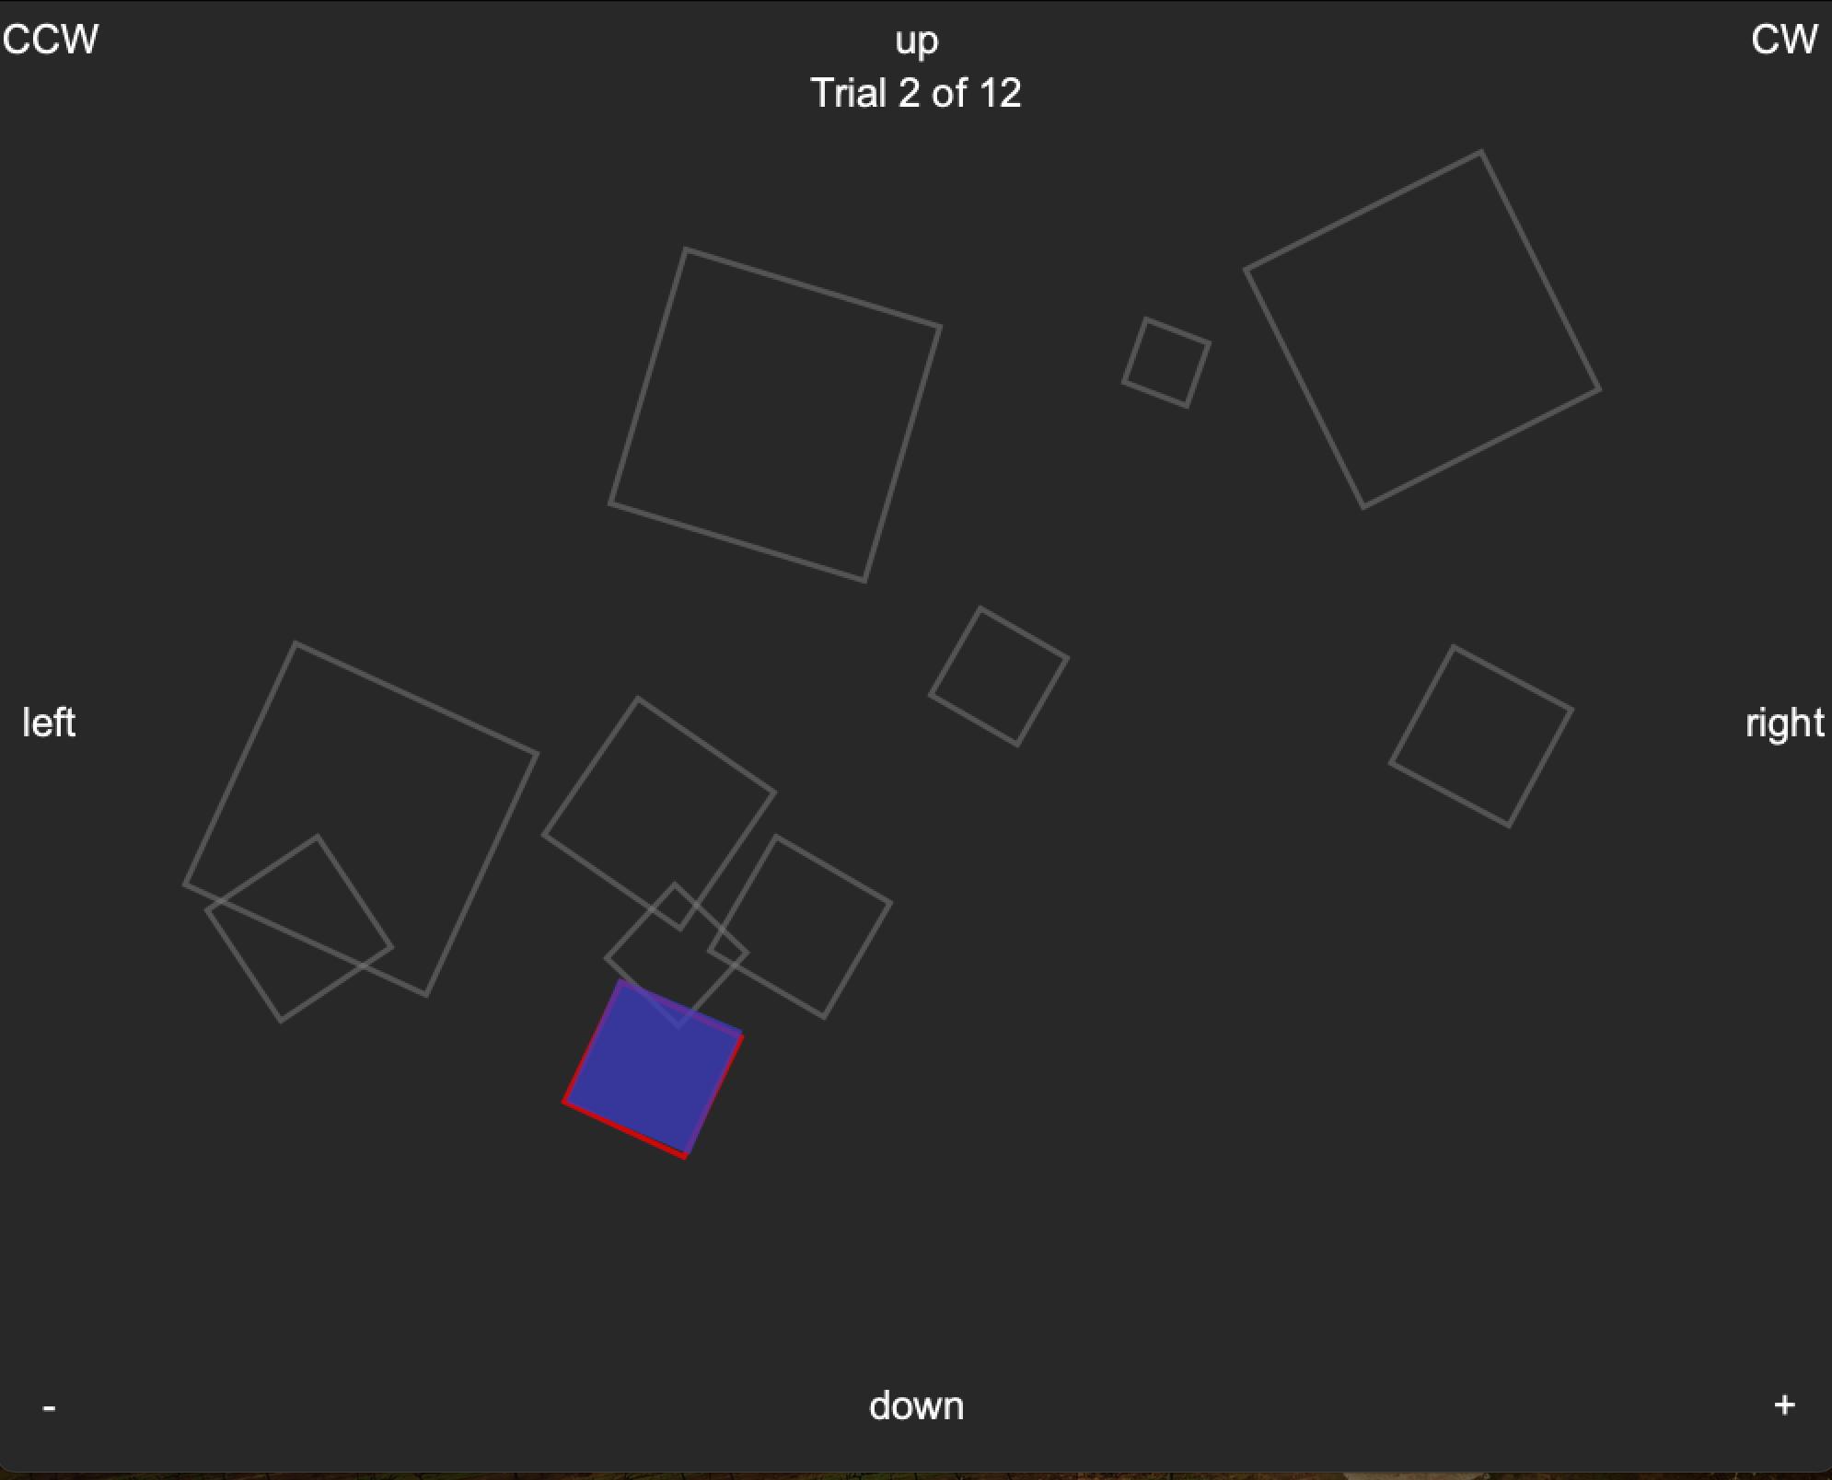
1st Prototype – With Initial Ideas
Show after

Slide 4
Initial Ideas Process
Explain process.

Slide 5
1st Testing
Times | Repeats = 1 | Repeats = 2 | Repeats = 3
Original | xx.xxx Seconds | Seconds | Seconds
Initial Ideas | Seconds | Seconds | Seconds

Slide 6
2nd Prototype -
Explain ideas

Slide 7
2nd Testing W/ Testers
Times | Repeats = 1 | Repeats = 2 | Repeats = 3
Original | 13.368 Seconds | 28.018 Seconds | 37.982 Seconds
Option 1 | 12.612 Seconds | 24.854 Seconds | 35.363 Seconds
Option 2 | 12.001 Seconds | 21.268 Seconds | 34.265 Seconds

Slide 8
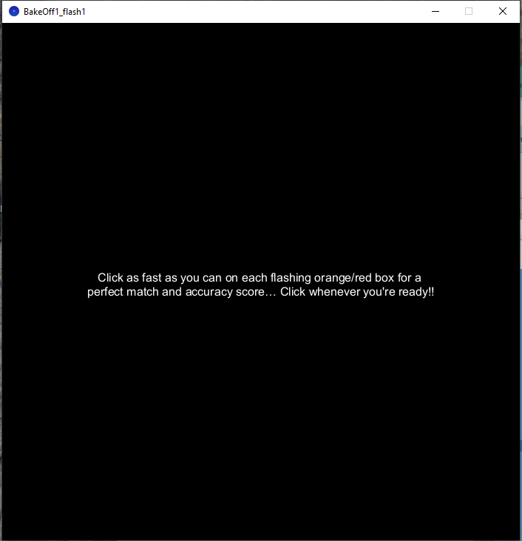
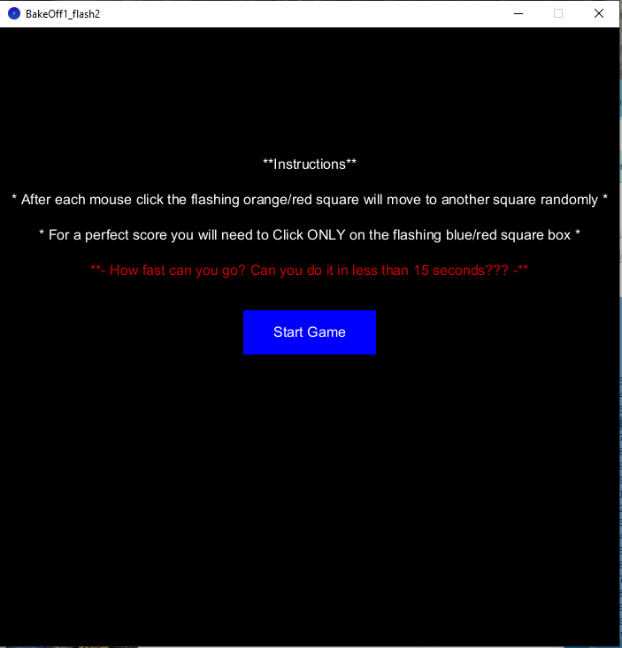
Final Refinement

Slide 9
Final Prototype
Times | Repeats = 1 | Repeats = 2 | Repeats = 3
With Start Game Button | 11.955 Seconds | 23.015 Seconds | 34.567 Seconds
“ Adding instructions, red challenge phrase, and a Start Game button ensures players know what to do, try to stay below the 15 seconds, and ensure that no accidental clicks start the game, unless click happens in the ‘Start Game’ button boundary.”

